Slide 1
ESEE READER- A Boon To Digital India

Slide 2
CONTENTS!..
ABSTRACT
PROTOTYPE ANALYSIS
IDEA AND UNIQUENESS
CODE DESIGN AND ANALYSIS
GOALS AND OBJECTIVES
OUTCOMES AND REFERENCES

Slide 3
ABSTRACT !..
“
THE MAIN OBJECTIVE OF THIS PROJECT, IS ON THE VIEW OF SAVING ELECTRICAL ENERGY, BY DISPLAYING THE ELECTRICITY BILL EQUIVALENT TO THE ELECTRIC ENERGY CONSUMED IN THE ENERGY METER.
SO THAT EACH AND EVERY INDIVIDUAL CAN KNOW THE EXACT COST OF THE ELECTRIC CONSUMPTION IN THEIR HOME AND ITS VERY EASY FOR PAYING BILLS TOO.
“
ESEE READER
- A Boon To Digital India

Slide 4
IDEA AND UNIQUENESS !..
IDEA UNIQUENESS
“ By displaying the equivalent cost of electric energy consumed in the energy meter people will realize the fact of increase in energy consumed and their bill amount and will start reducing consumption of energy.”
“Both energy and money will
be saved”
“Creating the idea of electric bill generation and its calculation among each every individual.”
“The ideology of making everyone benefitted by conserving energy for the future generation by the people itself and saving their valuable money. ”

Slide 5
GOALS AND OBJECTIVES !..
01
MAIN GOAL OF THIS PROJECT IS TO SAVE ENERGY.
02
REDUCE THE UN-NECESSARY WASTAGE OF ELECTRICITY.
03
REDUCE FINANCIAL RISK.
04
REDUCE FINANCIAL RISK.

Slide 6
GOALS AND OBJECTIVES!..
05
CONSERVATION OF ENERGY.
06
CREATING AWARENESS OF SAVING ENERGY TO PEOPLE BY PRACTICAL.
07
USER FRIENDLY.
08

Slide 7
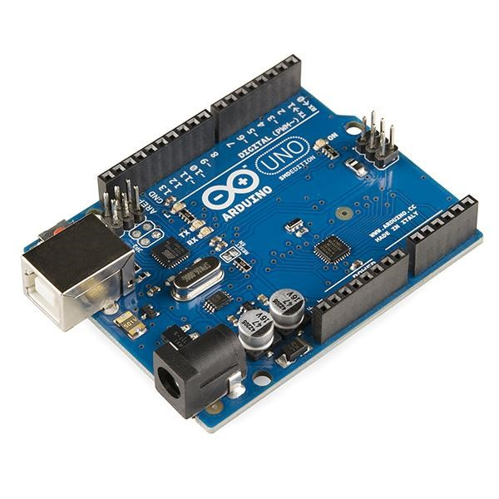
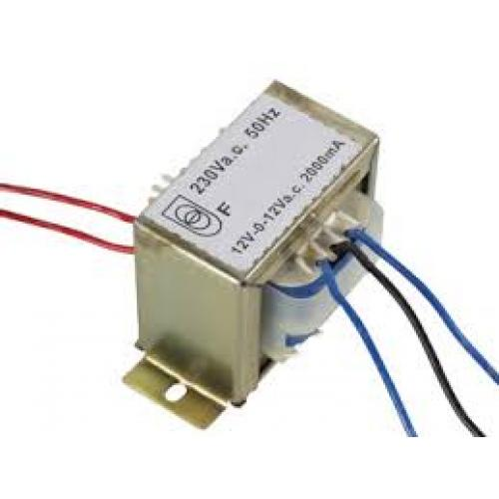
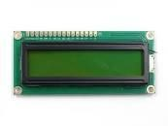
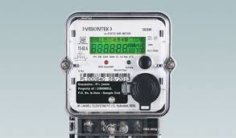
PROTOTYPE ANALYSIS !..
HARDWARE COMPONENTS / DEVICES
DIGITAL ENERGY
METER
TRANSFORMER
LCD DISPLAY
ARDUINO
BOARD
STEPS UP OR STEPS DOWN THE ELECTRIC CURRENT ACCORDIMG TO NEED
DISPLAY THE BILL AMOUNT AND ENERGY CONSUMPTION IN DIGITAL FORMAT
SOFTWARE PROGRAM IS CONVERTED INTO HARDWARE PROGRAM
MEASURES ELECTRIC ENERGY CONSUMED

Slide 8
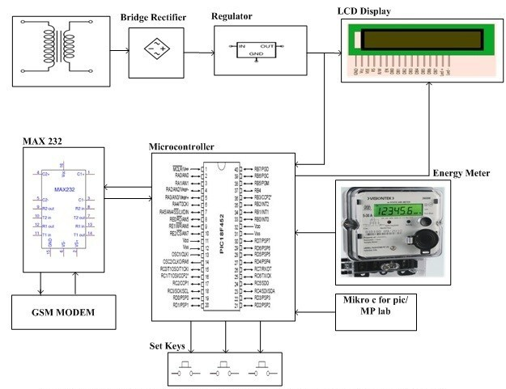
CIRCUIT ANALYSIS !..
PROTOTYPES USED IN CIRCUIT ANALYSIS:
ENERGY METER IS CONNECTED WITH LAMP LOADER IN THE THE AMOUNT ENERGY CONSUMED BY THE LOAD WILL BEMEASURED IN IT.
TRANSFORMER IS MADE CONNECTED WITH THE PCB BOARD IN WHICH RESISTORS,SENSORS ARE CONNECTED AND THE ARUDINOIS ALSO CONNECTED WITH THE PCB .
AURDINO IS THE ONE WHICH TRANSFERS THE AMOUNT OF ENERGY CONSUMED AND BILL AMOUNT TO THE LCD DISPLAY.
LCD DISPLAYS THE RESULT .

Slide 9

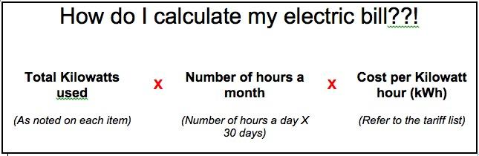
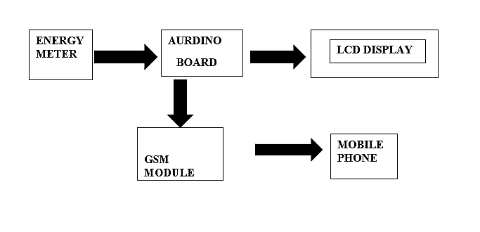
BLOCK DIAGRAM !...
FLOWCHART REPRESENTATION OF THE PROTOTYPE

Slide 10
CODE DESIGN !..
CODE TO CALCULATE TOTAL AMOUNT OF UNITS CONSUMED
ALGORITHM:
STEP 1: Start
STEP 2: Declare the variables PMR, CMR and UNITS.
STEP 3: Assign values to the variables PMR, CMR from the energy meter.
STEP 4: Calculate, UNITS=CMR-PMR
STEP 5: Get the result,”UNITS”
STEP 6: Stop.

Slide 11
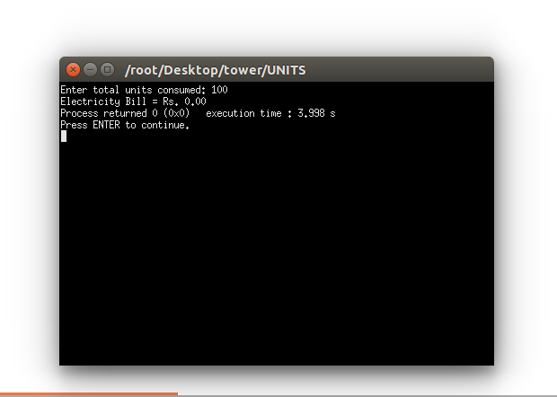
CODE ANALYSIS !..
OUTPUT FOR THE CODE BESIDE :
CODE TO CALCULATE THE TOTAL AMOUNT OF UNITS CONSUMED:
#include<studio.h>
void main()
{
int PMR,CMR,UNITS;
printf("PMR:");
scanf("%d",&PMR);
printf("CMR:");
scanf("%d",&CMR);
UNITS=CMR-PMR;
printf("UNITS:%d\n",UNITS);
}

Slide 12
CODE DESIGN !..
CODE TO CALCULATE TOTAL AMOUNT OF UNITS CONSUMED
ALGORITHM:
STEP 1: Start
STEP 2:Get the value of units consumed.
STEP 3:Declare the variable COST.
STEP 4:Check the condition given below an calculate the COST.
STEP 5: if (unit <= 100){
amt = (0+(unit *0));}
else if(unit>100 && unit<=200){
amt = (20+(unit * 2.50));}
else if(unit>200&&unit<=500){
amt = (30+(unit * 4.50));}
else{
amt= (50+(unit * 6.60));}
total_amt = amt ;}
STEP 6: Print the total amount of units consumed .

Slide 13
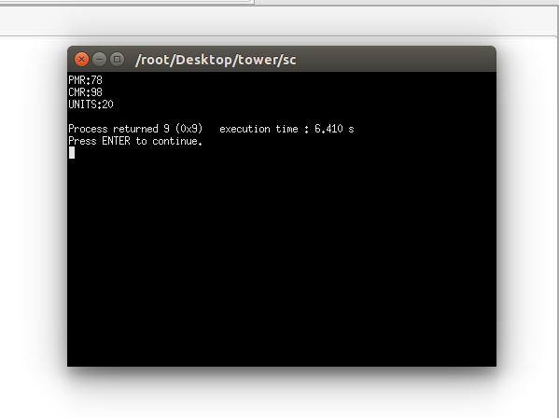
CODE ANALYSIS !..
CODE TO CALCULATE EQUIVALENT COST OF UNITS CONSUMED:
#include <stdio.h>
int main()
{
int unit;
float amt, total_amt;
printf("Enter total units consumed: ");
scanf("%d", &unit);
if(unit <= 100)
{
amt = (0+(unit *0));
}
else if(unit>100 && unit<=200)
{
amt = (20+(unit * 2.50));
}
else if(unit>200&&unit<=500)
{
amt = (30+(unit * 4.50));
}
else
{
amt= (50+(unit * 6.60));
}
total_amt = amt ;
printf("Electricity Bill = Rs. %.2f", total_amt);
return 0;
}
OUTPUT

Slide 14
THE OUTCOMES OF THE ESEE READER ARE !..
Automation Of All Features Including Communication Saves Data .
Saves Data Using Automatic Control And Storage Systems.
It Reduces Financial Risk.
It Creates An Easy And Fast Billing System.
This System Increases Productivity ,It Also Increases N Number Of Customers To Communicate And Automate.
OUTCOMES !...

Slide 15
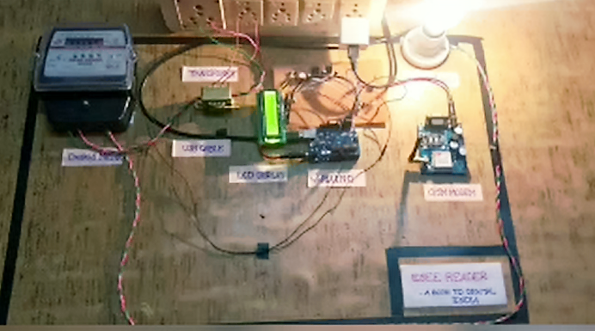
MODEL OF OUR PROJECT !..
ESEE READER
- A BOON TO DIGITAL INDIA

Slide 16
FUTURE ENHANCEMENT !..
“
THIS PROPOSED AUTOMATED EB MODEL INCLUDES CONSUMER HOME MODULE WHICH IS PRESENT AT A HOME THIS MODULE IS USED TO MAKE NOTES OF THE AMOUNT OF POWER CONSUMED BY THE CUSTOMER IS SENT AS A MESSAGE TO THEIR REGISTERED MOBILE NUMBER FOR THE PREFERENCE AND IT CAN ALSO BE VIEWED MANUALLY BY THE USER IN THEIR HOMES ITSELF
“
ESEE READER
- A Boon To Digital India

Slide 17
THANK YOU ☺

